Slide 1
AUTOMATION AND ROBOTICS
Satakunta

Slide 2
1
Fast Growth in Satakunta
Robocoast
RoboAI
Cimcorp
Importance for Finland and the Whole World
Strong Customer Base
5
Global AI Solutions from Satakunta
Elinar
HeadAI
2
3
4

Slide 3
Fast Growth in Satakunta
€
€
69,8% Growth in employee count 2010-2018
1259 Man-years 2018
61,4% Growth in total salary 2010-2017
56 M€ Salaries paid 2017
Notes:
http://www.satamittari.fi/Satakunnan_talous_-katsaus

Slide 4
97,2% Revenue growth 2010-2018
437 M€
Annual revenue 2018
Notes:
http://www.satamittari.fi/Satakunnan_talous_-katsaus

Slide 5
Robocoast
There is a cluster of more than 100 robotics, IoT, artificial intelligence and automation companies in Satakunta. The Robocoast Consortium is the center of this cluster. Robocoast is a Digital Innovation Hub, DIH, approved by the European Commission. In addition to the cluster companies, the Consortium includes RoboAI research and development center.
100+ companies
Notes:
https://robocoast.eu/
http://www.satamittari.fi/Satakunnan_talous_-katsaus

Slide 6
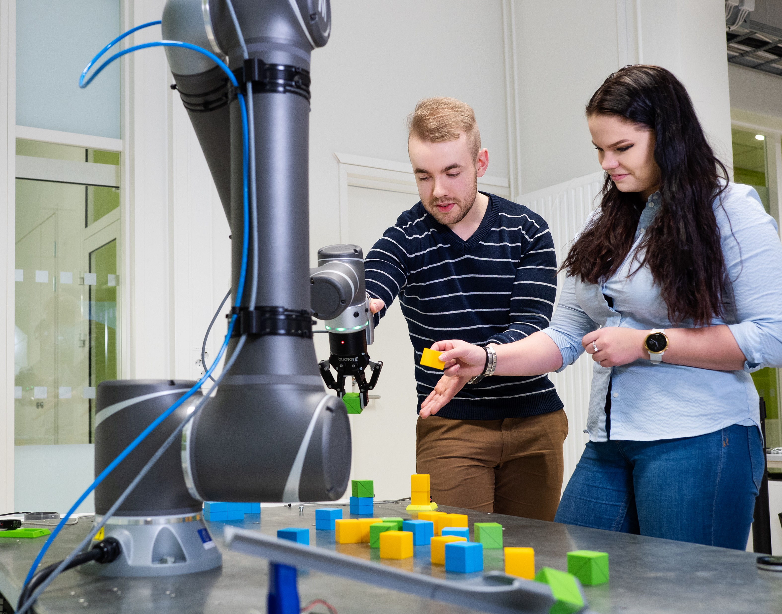
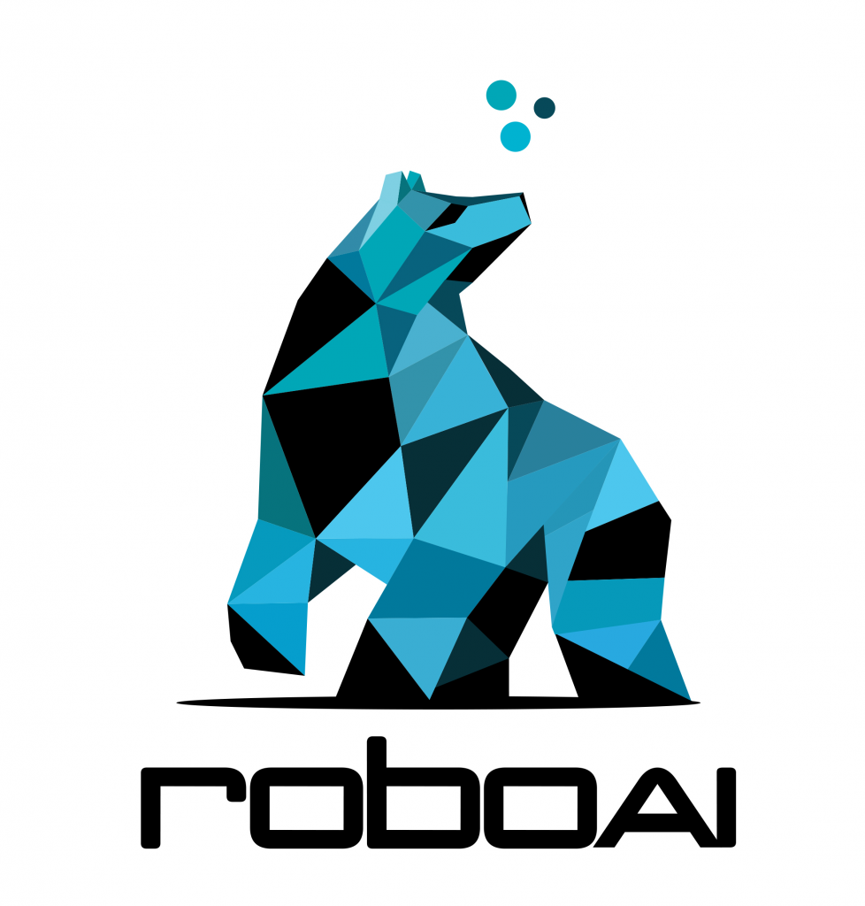
RoboAI
SAMK / Veera Korhonen
RoboAI is a research and development center that provides
product development services related to automation, robotics and artificial intelligence, and
startup services for students and entrepreneurs.
RoboAI is a joint project by Satakunta University of Applied Sciences (SAMK) and Pori Unit of Tampere University.
20+ experts in automation, robotics and AI
Notes:
https://www.roboai.fi/

Slide 7
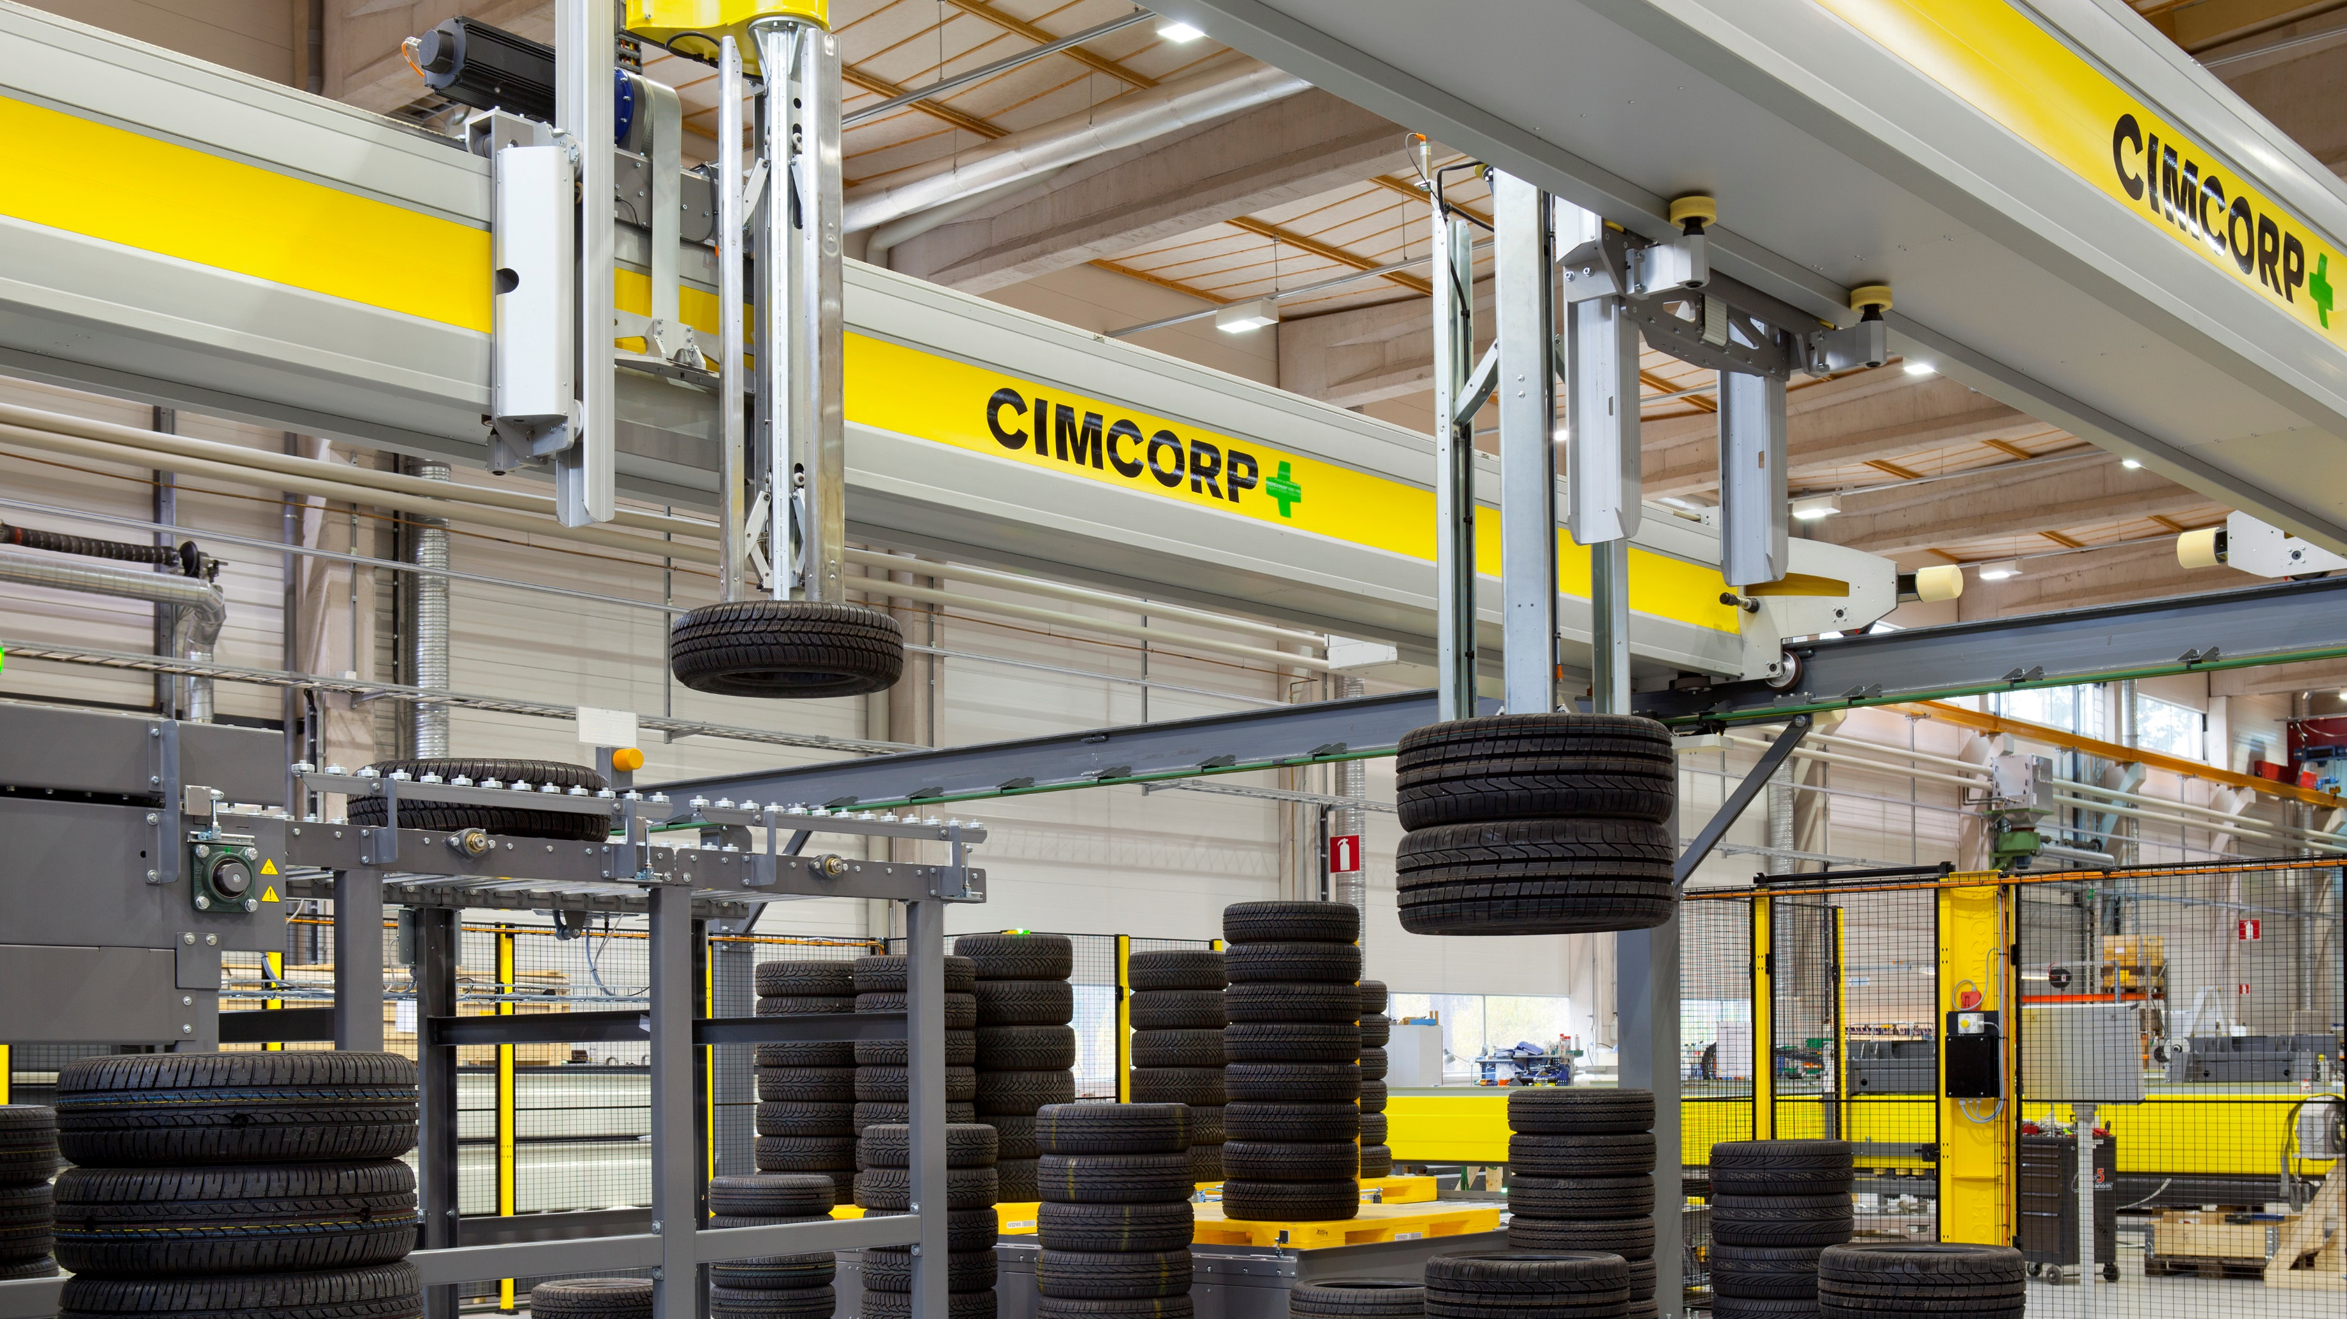
Cimcorp
Cimcorp is a global supplier of automation solutions for, for example, tire, food & beverage, e-commerce, and postal service sectors. The global headquarters, Cimcorp Oy, is located in Ulvila, Satakunta. Additionally, the Cimcorp Group has branches in Canada, the US, India and Spain.
JOURNEY TO AUTOMATION AWARD 2020
– A leading player in the field of automation and digital transformation of the tire industry
Cimcorp / Esa Kyyrö
Notes:
https://www.cimcorp.com/
https://www.cimcorp.com/en/media/news/cimcorp-won-journey-to-automation-award

Slide 8
Importance for Finland and the Whole World
2019
€
€
130 M€ Annual revenue of
Cimcorp Group
100 M€ Annual revenue of
Cimcorp Oy
500 Employees at
Cimcorp Group
340 Employees at
Cimcorp Oy
Notes:
https://www.kauppalehti.fi/yritykset/yritys/cimcorp+oy/1852828-4
https://www.businessfinland.fi/4a113e/globalassets/finnish-customers/02-build-your-network/bioeconomy--cleantech/sustainable-manufacturer/cimcorp.pdf

Slide 9
Strong Customer Base
Cimcorp has supplied
automation solutions to
40+ COUNTRIES ACROSS
6 CONTINENTS
Examples of Cimcorp’s references include
Cordiant’s Yaroslavl factory – one of the biggest tire plants in Russia
Fazer – among Finland’s largest food companies with its 1.1 B€ turnover
L’Oréal – the world's largest cosmetics company
Mercadona – leader in the Spanish grocery retail market
PostNord – the leading supplier of communications and logistics solutions in the Nordic region
Cimcorp
Notes:
https://www.cimcorp.com/en

Slide 10
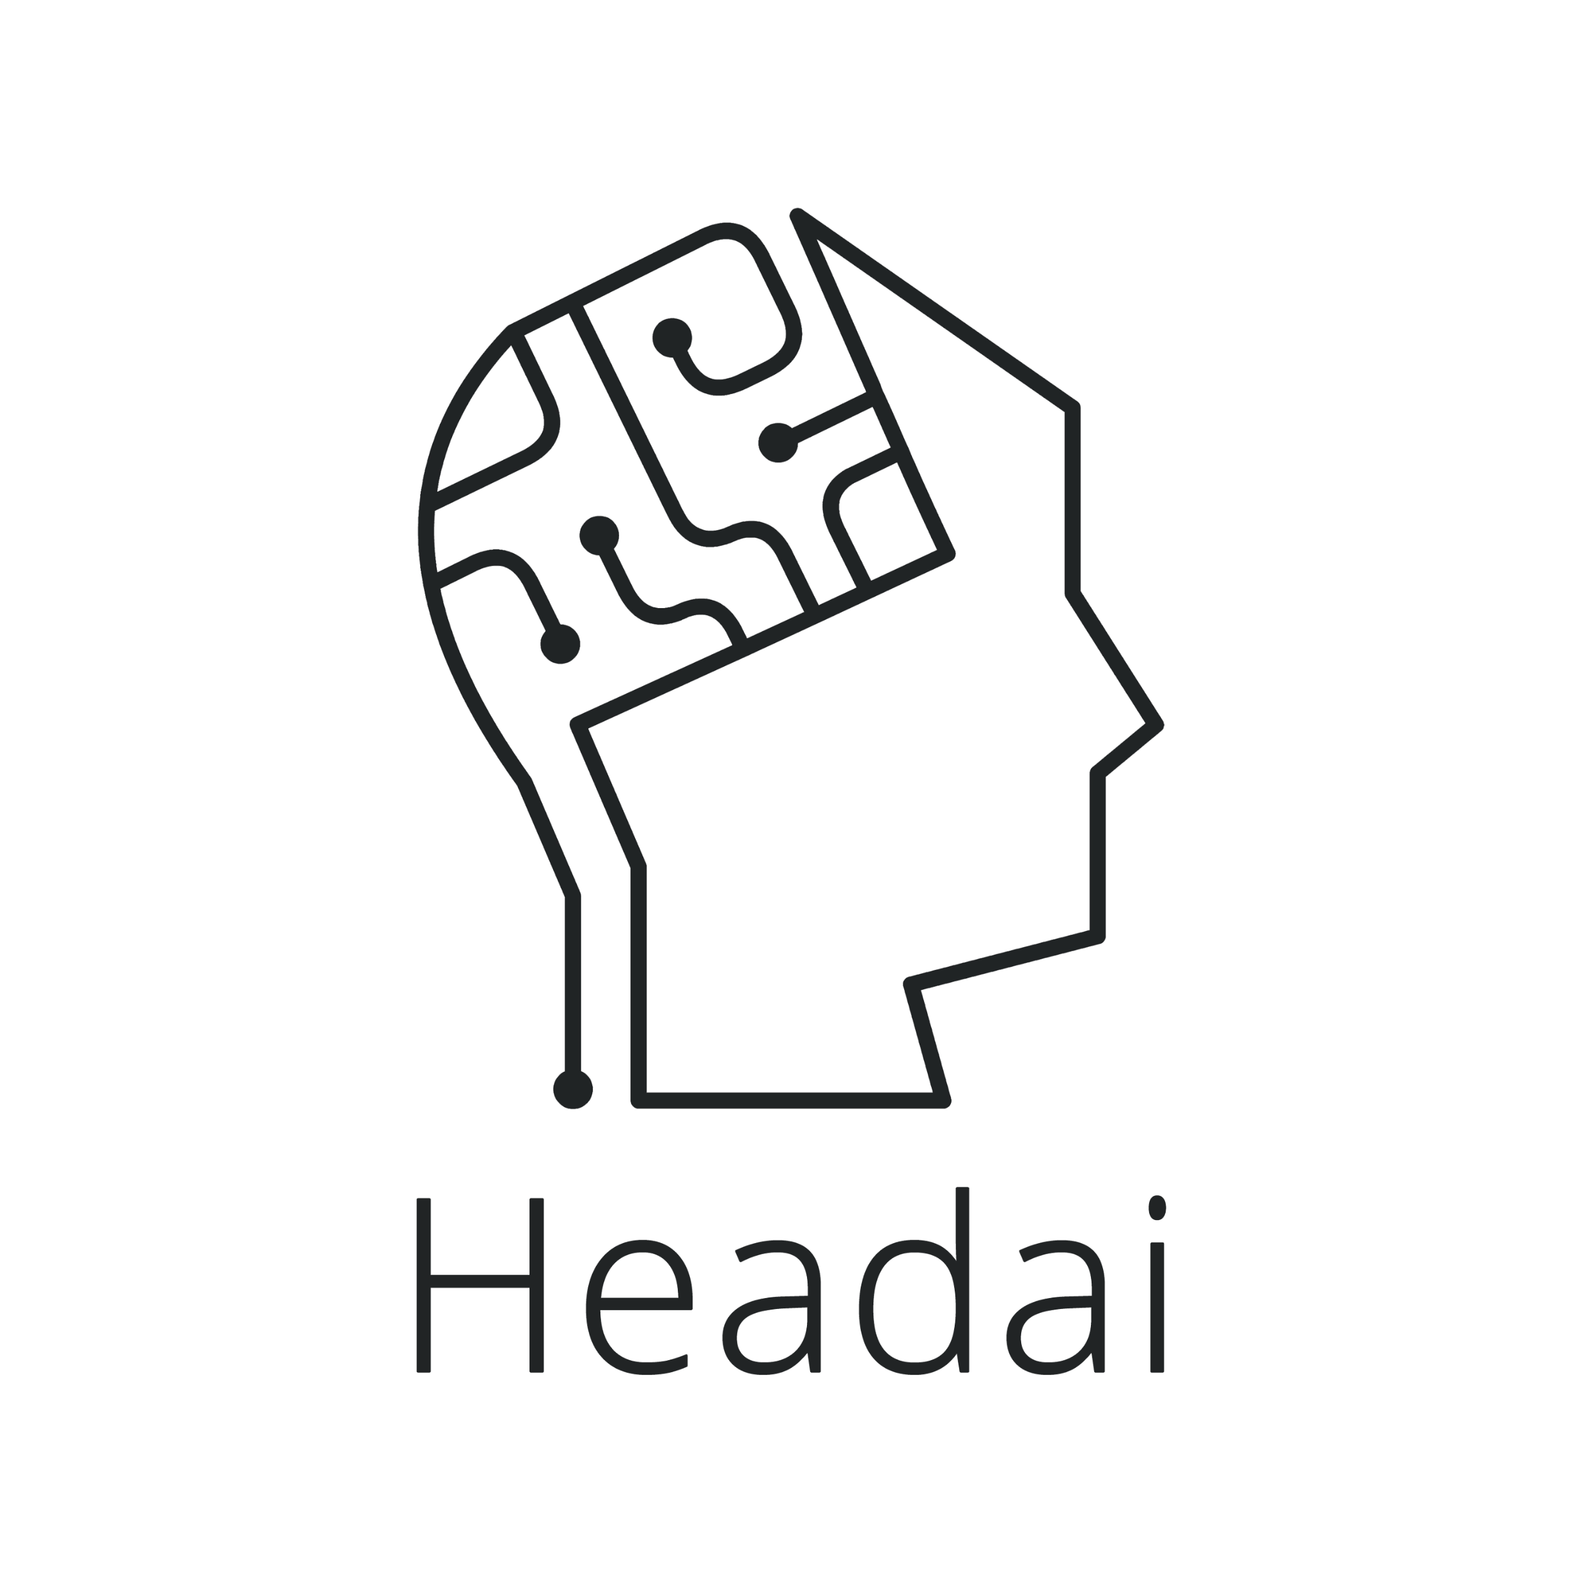
Global AI Solutions from Satakunta
There are several nationally and internationally significant AI companies in Satakunta. Elinar and HeadAI are two excellent examples.
References include, among others, Ministry of Economic Affairs and Employment, the Social Insurance Institution of Finland, and the service and trading company Bertel O. Steen (BOS).
Collaboration with for example Business Finland, Helsinki Central Library Oodi, and the World Bank.
Notes:
https://medium.com/headai-customer-stories
https://www.elinar.com/references/

Slide 11
Winner
IBM Outstanding Hybrid Cloud Solution Award 2020
Wild Card
Champion
IBM Watson Build Challenge 2017, where participants developed IBM Watson based solutions
Winner
Workflow Management Coalition’s Global Awards for Excellence in Case Management
2017
Notes:
https://www.elinar.com/satakunta-ai/
https://www.elinar.com/2017/07/20/elinar-solution-winner-global-awards-excellence-case-management/
https://www-356.ibm.com/partnerworld/wps/servlet/ContentHandler/watson-build-resources-champions
https://www.elinar.com/2020/10/08/elinar-was-rewarded-for-successful-integration-of-its-own-ai-with-ibm-technology/

Slide 12
Winner
Ratkaisu100 in 2017, which aimed at finding a solution for better identification and utilization of expertise
13th place
Startup100 – the hottest startups from Finland, May 2020
National
Winner
World Summit Award 2018 – a competition rewarding startups working with digital innovations
Finals
Alibaba Cloud Computing Contest in London 2017
Notes:
https://www.elinar.com/satakunta-ai/
https://medium.com/headai-news/vuoden-2020-paras-digitaalinen-oppimissovellus-hy%C3%B6dynt%C3%A4%C3%A4-headain-teko%C3%A4ly%C3%A4-c0bb33358ca6
https://www.sitra.fi/aiheet/ratkaisu100/
http://www.ilkkakurkela.fi/finnish-winners-un-wsa/
https://medium.com/headai-news/headai-in-top-15-hottest-startups-in-finland-87467c28f29e

